Slide 1
IMDB MOVIE ANALYSIS
Project no. 5 :- USING EXCEL STATISTICS

Slide 2
PROBLEM DESCRIPTION
The dataset provided is related to IMDB Movies. A potential problem to investigate could be: "What factors influence the success of a movie on IMDB?" Here, success can be defined by high IMDB ratings. The impact of this problem is significant for movie producers, directors, and investors who want to understand what makes a movie successful to make informed decisions in their future projects.
IMDB is a wellknown movie and series rating site for users and critics worldwide. In IMDB we can find movies or series rating as well as its directors and actors compiled profile as well as financials of it. We are provided with IMDB dataset from 1920 to 2010 which contains information about the movie its actors , directors , budget , collection etc. We’ll be going to clean the dataset and get the required answers with the Five Whys method for analysis using MS EXCEL.

Slide 3
APPROACH AND TECH STACK
We’ll first understand the data and then we will clean the data , get rid of null and duplicate values and unnecessary columns etc. We will use various charts and functions to get the answers of the required questions and lets see how our project goes.
TECH-STACK USED: MS EXCEL , VISUALIAZATION.

Slide 4
TASK TO CARRY OUT IN THIS PROJECT
TASKS :-
MOVIE GENRE ANALYSIS.
MOVIE DURATION ANALYSIS.
LANGUAGE ANALYSIS.
DIRECTOR ANALYSIS.
BUDGET ANALYSIS.

Slide 5

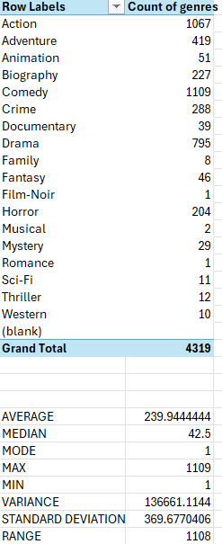
MOVIE GENRE ANALYSIS.
Analyze the distribution of movie genres and their impact on the IMDB score.
Determine the most common genres of movies in the dataset. Then, for each genre, calculate descriptive statistics (mean, median, mode, range, variance, standard deviation) of the IMDB scores.
We will use the COUNTIF function to count the number of movies for each language using descriptive statistics.
IN EXCEL , TASK 1 IS DONE USING PIVOT TABLE
VALUES IN THE TASKS ARE VARIABLE BECAUSE OF THE SORTING.

Slide 6
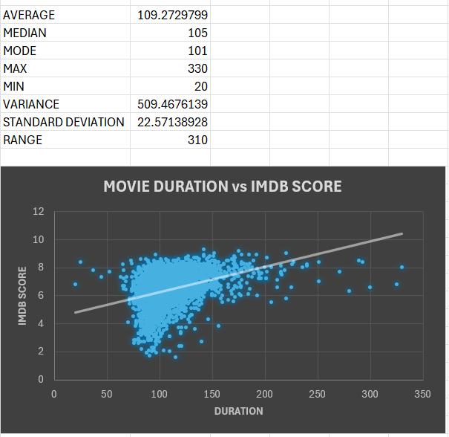
B.MOVIE DURATION ANALYSIS
Analyze the distribution of movie durations and identify the relationship between movie duration and IMDB score.
We will first use descriptive statistics and then find the AVG, MEDIAN and STANDARD DEVIATION and create a scatter plot to visualize relationship between MOVIE DURATION and IMDB SCORE.

Slide 7
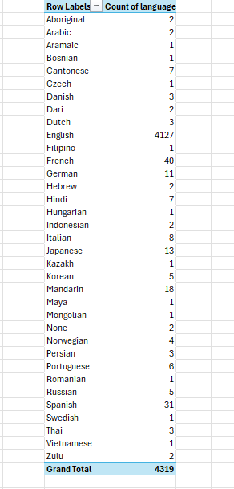
C.LANGUAGE ANALYSIS.
Examine the distribution of movies based on their language.
Determine the most common languages used in movies and analyze their impact on the IMDB score using descriptive statistics.
We will use the COUNTIF function and then calculate MEAN, MEDIAN, STANDARD DEVIATION of the IMDB SCORE for each language and then compare the statistics
Most Common language is ENGLISH.

Slide 8
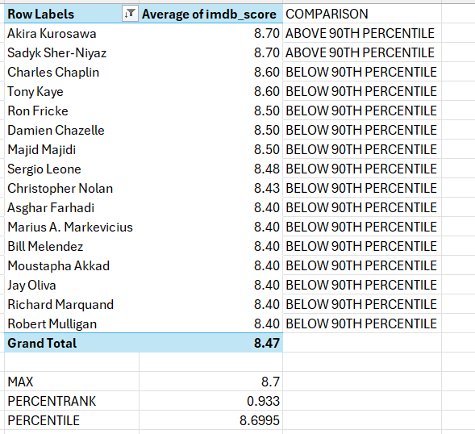
D.DIRECTOR ANALYSIS..
Influence of directors on movie ratings.
Identify the top directors based on their average IMDB score and analyze their contribution to the success of movies using percentile calculations.
We will calculate the average IMDB SCORE for each director and then use excel’s PERCENTILE function to identify the directors with the highest scores.

Slide 9
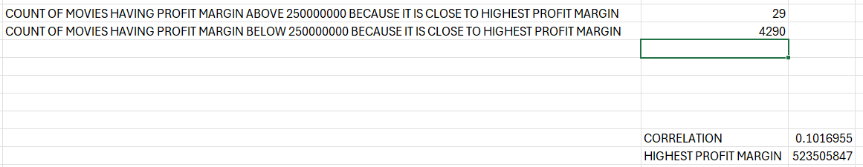
E.BUDGET ANALYSIS.
Explore the relationship between movie budgets and their financial success.
Analyze the correlation between movie budgets and gross earnings , and identify the movies with the highest profit margin.
We will use CORREL function and calculate the profit margin for each movie and identify the movies with the highest profit margin using the MAX function.

Slide 10
INSIGHTS
We clean the data , get rid of the null values , duplicate values blank cells.
Apply the knowledge of EXCEL and STATISTICS and get the desired output of all the 5 tasks that were required.
Handling the first task took the longest time and for the rest of the task time required started to decline as compared to first task.
We got all the tasks done and the knowledge of Excel increased a lot , overall it was a Very good project.

Slide 11
CONCLUSION
TASK 1 proved to be very confusing and tedious for me as I was not getting the point of what to do even with the hints given, even after that I have tried my level best to get the answer required. In this task we found out what GENRE impacts the IMDB SCORE the most.
TASK 2 was done quickly as compared to TASK 1 as it was a bit simple. In this we found out the relation between MOVIE DURATION and IMDB SCORE using the SCATTERPLOT.
TASK 3 was a bit tricky but it was solved soon enough and we got the desired output.
TASK 4 was challenging in the percentile part rest was easy and we got the work done and got the comparison of who is the best director.
TASK 5 was to find out about the highest profit and was very easily done and thus we have carried out all the tasks successfully and understanding of EXCEL and STATISTICS has increased.
EXCEL LINK
GOOGLE DRIVE LINK

Slide 12
THANK YOU.

